Slide 1

Theoretical Perspectives
in
Sociology
Ms. Kauser Malik
Lecturer (Sciences & Humanities)

Slide 2
Learning Outcomes
Learning different theoretical perspectives of sociology
Learning how these perspectives are applied in today’s world

Slide 3
Topics To Be Covered
Levels of Analysis: Microsociology and Macrosociology
Structural Functionalism
Conflict Theory
Symbolic Interactionist
Feminist
Major Sociological Perspectives

Slide 4
Levels of Analysis: Macro Sociology and Micro Sociology
Microsociology
Individual interactions
Macrosociology
Society as a whole

Slide 5
An approach to sociology which emphasizes the analysis of social systems and populations on a large scale, and at the level of social structure to determine how it affects the lives of groups and individuals.
The study of larger organizations, communities and societies that individuals live in.
Focusses on groups, populations, social structures
Important concepts: Institutions, inequality, impact of the social environment on people’s interactions.
Example: How does racial inequality influence how minorities access healthcare?
In the field of sociology, the study of individuals is called microsociology.
Focusses on individual attributes and interactions.
Important concepts: Communication, symbols, reciprocity, interpersonal exchange.
Example: How does the interaction between a doctor and a patient reflect racial inequality?
Macrosociology
Microsociology
It looks at small-scale interactions between individuals, such as conversation or group dynamics.
It looks at the smallest building blocks of society in order to understand its large- scale structure.

Slide 6
Society
Culture
Interaction
Social Institutions
(Economics, Politics, Education, Religion)
Groups
Roles
Socialization
Self
Social Inequality
(Class, Race, Gender)
Macro-Micro Continuum

Slide 7
Macrosociological Theory
1. Structural Functionalism
Founder and Key Contributions

Slide 8
Structural Functionalism - Founder and Key Contributions
Émile Durkheim (1858–1917) is the central ﬁgure in functionalist theory.
Durkheim’s attempt to establish sociology as an important, independent academic discipline was enormously successful.
He not only made signiﬁcant contributions to the existing literature but also demonstrated the effectiveness of using scientiﬁc, empirical methods to study “social reality.”

Slide 9
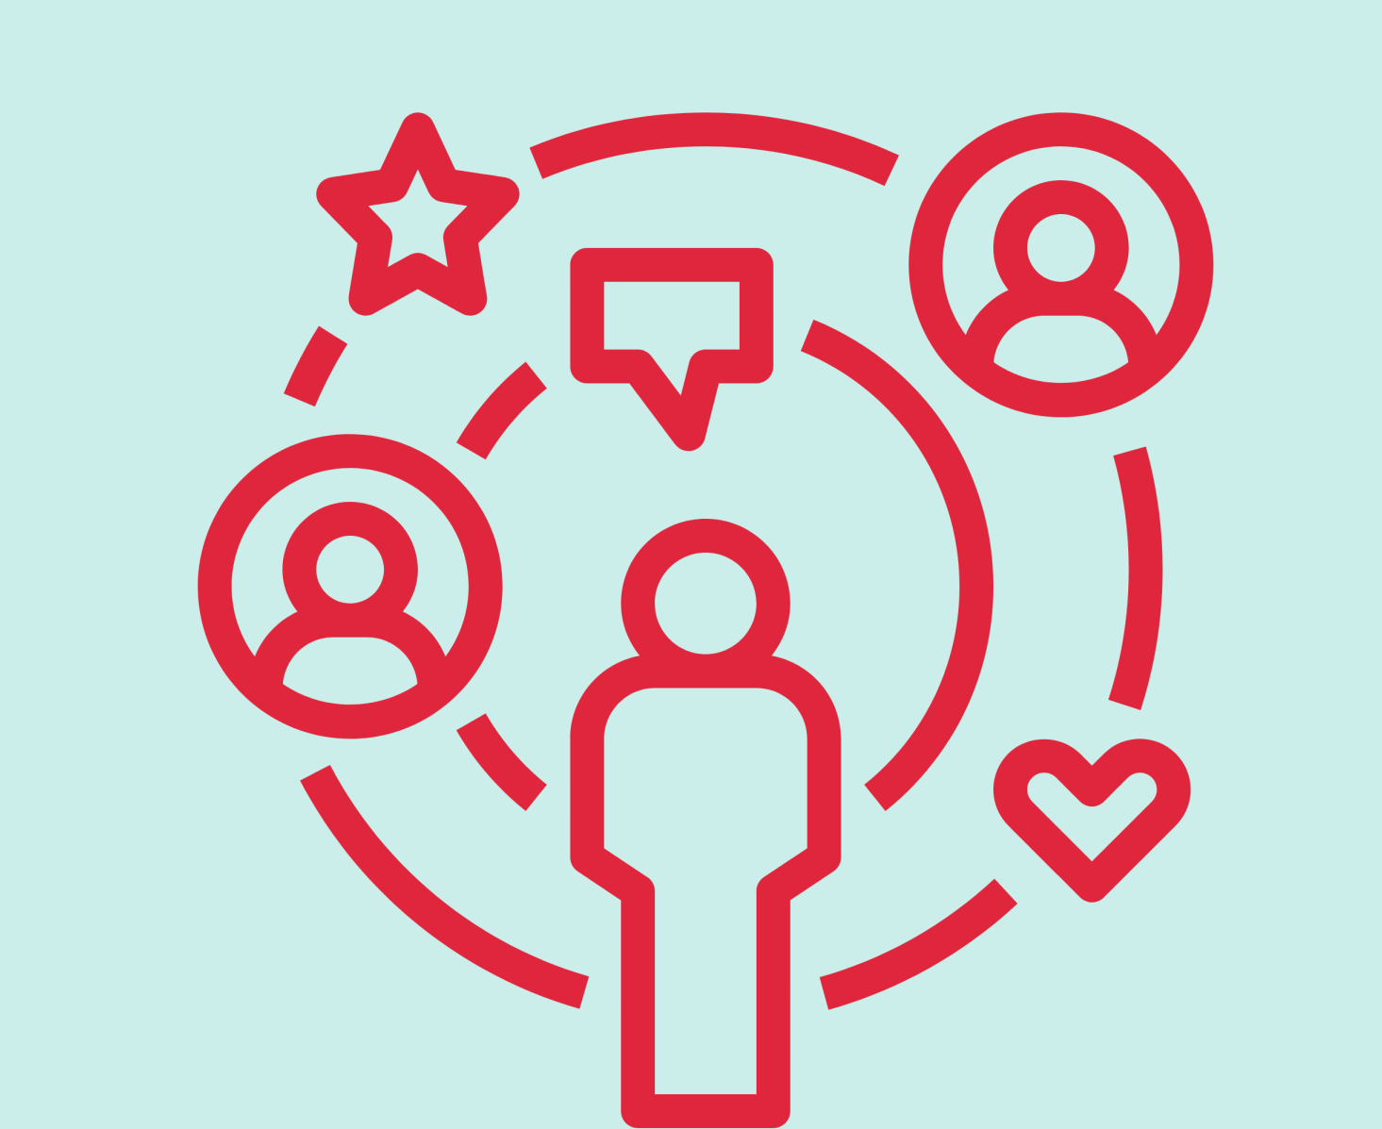
Functionalism/ Structural Functionalism
The structural-functional approach is a framework for building theory that sees society as a complex system whose parts work together to promote solidarity and stability.
central idea of functional analysis - society is a whole unit, made up of interrelated parts that work together. Very important for any society to stay stable and continue.
This approach points to social structure, any relatively stable pattern of social behavior. Social structure gives our lives shape—in families, the workplace, the classroom, and the community.
This approach also looks for a structure’s social functions, the consequences of any social pattern for the operation of society as a whole. All social structures, from a simple handshake to complex religious rituals, function to keep society going, at least in its present form.

Slide 10

Functionalism
The main concept in functionalism is solidarity, indicating how well the different elements of the society can work together to attain the main goal of continuity of the society.
According to Durkheim, when all the parts of society fulfill their functions, society is in a “normal” state. If they do not fulfill their functions, society is in an “abnormal” or “pathological” state.
According to functionalists, to understand society, we need to look at both structure (how the parts of a society fit together to make the whole) and function (what each part does, how it contributes to society).

Slide 11
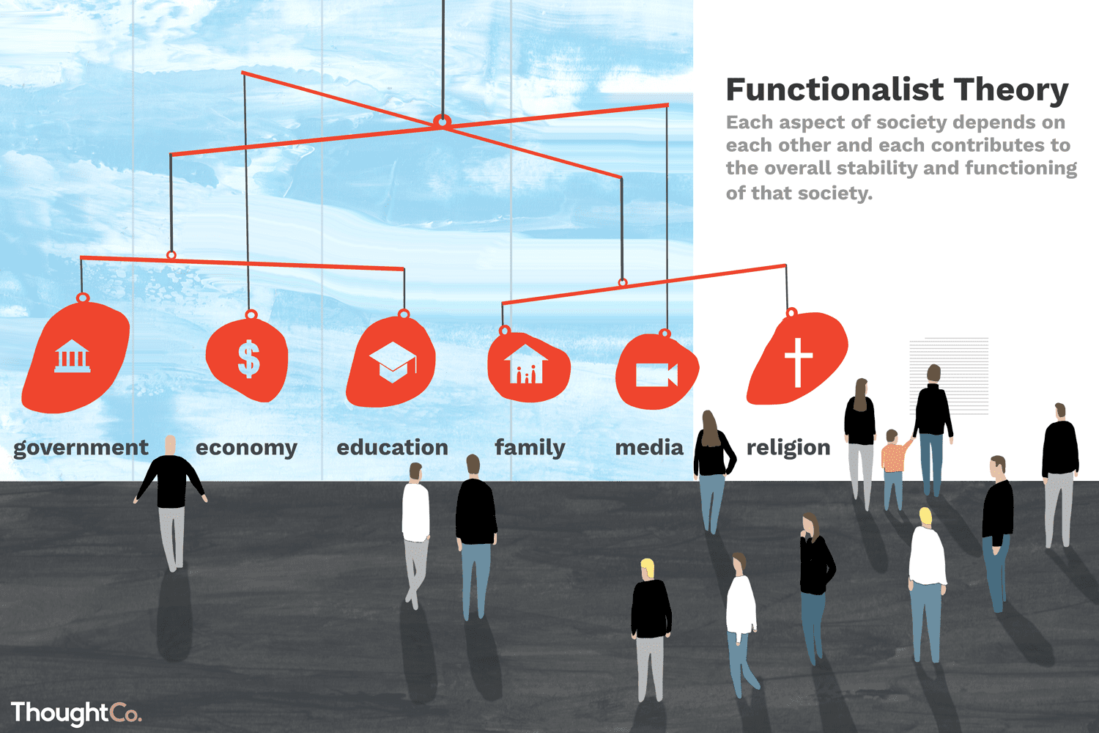
Main Principles of Functionalism

Slide 12
There are two main principles of functionalism:
1. Society is conceived as a stable, ordered system made up of interrelated parts, or structures.
2. Each structure has a function that contributes to the continued stability or equilibrium of the uniﬁed whole.
Structures are identiﬁed as social institutions such as the family, the educational system, politics, the economy, and religion. They meet society’s needs by performing different functions, and every function is necessary to maintain social order and stability.
From the functionalist perspective, society appears quite stable and self-regulating. Most members of a society share a value system and know what to expect from one another.

Slide 13
Interdependent Relationships
Businesses pay taxes to the government
Government uses taxes to fund school system
Schools educate so people can get jobs
Jobs allow people to spend money at local businesses

Slide 14

Interactions between parts of society
Education and Government
Government determines public school hours
Example: After-school daycare programs illustrate interactions between
Economy and Family
Two earners needed
Education and Family
School hours affect possible working hours

Slide 15
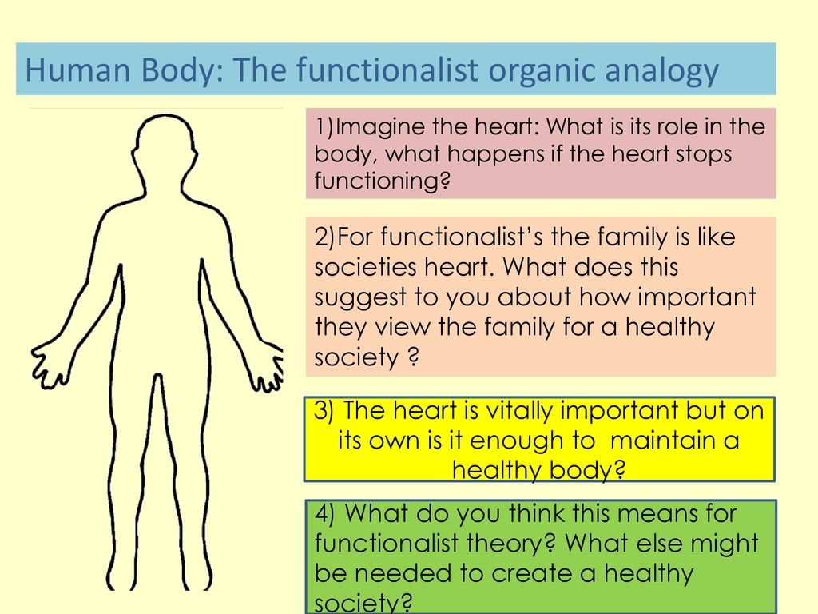
The structural-functional approach owes much to Auguste Comte, who pointed out the need to keep society unified at a time when many traditions were breaking down. Emile Durkheim, who helped establish the study of sociology in French universities, also based his work on this approach.
A third structural-functional pioneer was the English sociologist Herbert Spencer (1820–1903). Spencer compared society to the human body. Just as the structural parts of the human body—the skeleton, muscles, and various internal organs—function interdependently to help the entire organism survive, social structures work together to preserve society. The structural-functional approach, then, leads sociologists to identify various structures of society and investigate their functions.

Slide 16
Merton pointed out that any social structure probably has many functions, some more obvious than others. He distinguished between manifest functions and latent functions.
Example: System of higher education is to provide young people with the information and skills they need to perform jobs after graduation.
One of college’s latent function as a “marriage broker,” bringing together young people of similar social backgrounds.
Another latent function of higher education is to limit unemployment by keeping millions of young people out of the labor market, where many of them might not easily find jobs.
Social Functions
The consequences of a social pattern for the operation of society as a whole.
Manifest Functions
The recognized and intended consequences of any social pattern.
Latent Functions
The unrecognized and unintended consequences of any social pattern.

Slide 17

But Merton also recognized that not all the effects of social structure are good. Thus a social dysfunction is any social pattern that may disrupt the operation of society. Globalization of the economy may be good for some companies, but it also can cost workers their jobs as production moves overseas.
Therefore, whether any social patterns are helpful or harmful for society is a matter about which people often disagree.
In addition, what is functional for one category of people (say, high profits for Wall Street bank executives) may well be dysfunctional for other categories of people (workers who lose pension funds invested in banks that fail or people who cannot pay their mortgages and end up losing their homes).

Slide 18
Advantages and Critiques
One of the great advantages - inclusion of all social institutions. Functionalism attempts to provide a universal social theory, a way of explaining society in one comprehensive model.
In the mid-1900s, most sociologists favored the structural-functional approach. In recent decades, however, its influence has declined. By focusing on social stability and unity, critics point out, structural-functionalism ignores inequalities of social class, race, and gender, which cause tension and conflict. In general, its focus on stability at the expense of conflict makes this approach somewhat conservative.
Its focus on the macro level also means that functionalism has less interest in explaining independent human action; there is no apparent approach to the lives of individuals except as part of social institutions.
Functionalism’s explanations of social inequality are especially unsatisfying. If poverty, racism, and sexism exist, they must serve a function for society; they must be necessary and inevitable. This view is problematic for many. As a critical response, sociologists developed the social-conflict approach.
Provides little insight into social processes because its model of society is static rather than dynamic.

Slide 19
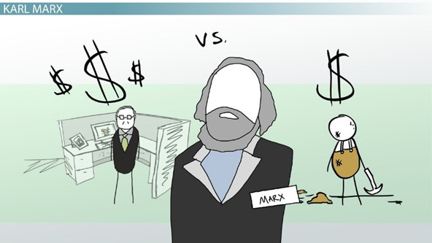
2. Conflict Theory
Founder and Key Contributions

Slide 20

Conflict Theory - Founder and Key Contributions
The work of Karl Marx (1818–1883), a German social philosopher, cultural commentator, and political activist, was the inspiration for conﬂict theory, so the terms “conﬂict theory” and “Marxism” are sometimes used interchangeably in the social sciences. Marx’s ideas have become better known to the world as the basis for communism.
Sociologists have found that Marx’s theory continues to provide a powerful tool for understanding social phenomena.
The idea that conﬂict between social groups is central to the workings of society and serves as the engine of social change is one of the most vital perspectives in sociology today.

Slide 21
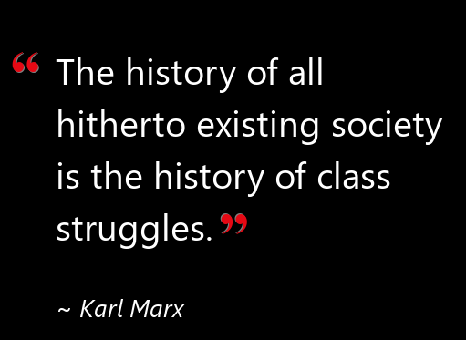
Conﬂict theory is the second major school of thought in sociology. Like structural functionalism, it’s a macro-level approach to understanding social life that dates to mid-nineteenth century Europe.
As conﬂict theory developed, however, its emphasis on social inequality as the basic characteristic of society helped answer some of the critiques of structural functionalism.
According to conflict theory, different groups in society compete over limited resources. The founder of conflict theory, witnessed the Industrial Revolution that transformed Europe. He saw that peasants who had left the land to work in cities earned barely enough to eat. Things were so bad that the average worker died at age 30, the average wealthy person at age 50. The capitalists control the legal and political system: If the workers rebel, the capitalists call on the power of the state to subdue them.
As he did so, he developed conflict theory. He concluded that the key to human history is class conflict.
Unlike the functionalists, who view society as a harmonious whole with its parts working together, conflict theorists stress that society is composed of groups that compete with one another for scarce resources.

Slide 22
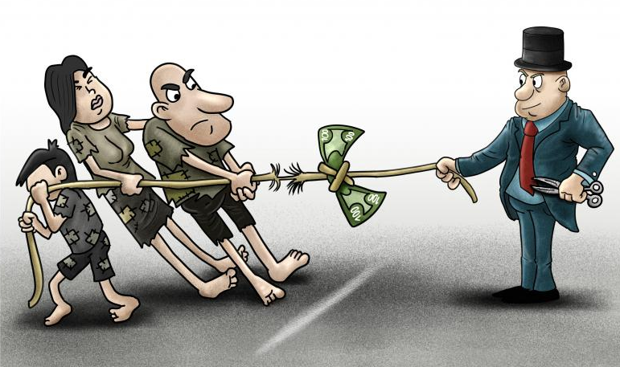
Original Principles
Conﬂict theory proposes that conﬂict and tension are basic facts of social life and suggests that people have disagreements over goals and values and are involved in struggles over both resources and power.
The wealthy and powerful bourgeoisie control major social institutions, reinforcing the class structure so that the state, education, religion, and even the family are organized to represent their interests. Conﬂict theory takes a critical stance toward existing social arrangements and attempts to expose their inner workings.
Conﬂict theory sees the transformation of society over time as inevitable. Marx argued that the only way to change the status quo is for the masses to attain class consciousness. This can happen only when people recognize how society works and challenge those in power. He believed that social change would occur when there was enough tension and conﬂict.

Slide 23
Conflict Theory Today
Many sociologists extend conflict theory beyond the relationship of capitalists and workers. They examine how opposing interests run through every layer of society—whether in a small group, an organization, a community, or an entire society.
For example, when teachers, parents, or the police try to enforce conformity, this creates resentment and resistance. It is the same when a teenager tries to "change the rules” to gain more independence. Throughout society, then, there is a constant struggle to determine who has authority or influence and how far that dominance goes (Turner 1978; Piven 2008; Manza and McCarthy 2011).
Minimum wages, eight-hour days, coffee breaks, five-day work weeks, paid vacations and holidays, medical benefits, sick leave, unemployment compensation, Social Security, and, for union workers, the right to strike. These benefits came not from generous hearts, but by workers forcing concessions from their employers.

Slide 24
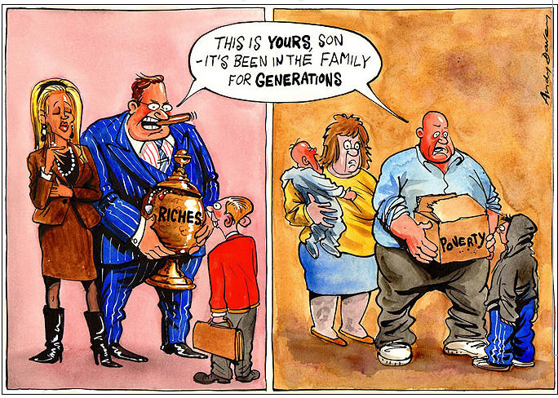
Advantages and Critiques
Young people from privileged families get the best schooling, which leads them to college and later to high-income careers. The children of poor families, by contrast, are not prepared for college and, like their parents before them, typically get stuck in low-paying jobs. In both cases, the social standing of one generation is passed on to the next, with schools justifying the practice in terms of individual merit (Bowles & Gintis, 1976; Oakes, 1982, 1985; Brunello & Checchi, 2007).

Slide 25
Advantages and Critiques
Marxist ideas have been important in achieving change through many twentieth - century social movements, including civil rights, antiwar, women’s rights, gay rights, animal rights, environmentalism, and multiculturalism.
Conﬂict theory is useful in understanding not only macro-level social issues (such as systematic discrimination against minority groups) but also micro-level personal interactions (such as those between bosses and employees). The theory challenges the status quo and emphasizes the need for social upheaval.
In focusing on tension and conﬂict, however, conﬂict theory can often ignore those parts of society that are truly orderly, stable, and enduring. Although society certainly has its share of disagreements, there are also shared values and common beliefs that hold it together. Conﬂict theory can be criticized for overlooking these less controversial dimensions of social reality.

Slide 26
Social-conflict Approach
A framework for building theory that sees society as an arena of inequality that generates conflict and change.
Gender-conflict Theory (Feminist Theory)
The study of society that focuses on inequality and conflict between women and men
Feminism
Support of social equality for women and men.
Race-conflict Theory
The study of society that focuses on inequality and conflict between people of different racial and ethnic categories.

Slide 27
Functionalism Versus Conflict Theory
Functionalism
Pioneer is Emile Durkheim
Theory that states that all aspects of society serve a function and are necessary for survival of that society.
Conflict Theory
Pioneer is Karl Marx
Theory that states there is a perpetual class conflict in the society due to the unequal distribution of resources.
States that all elements of the society are interdependent and they serve as a function for the overall stability of the society.
Focuses on the concept of social inequality in the division of resources and therefore, the conflicts that exists between classes, which will eventually trigger social change.

Slide 28
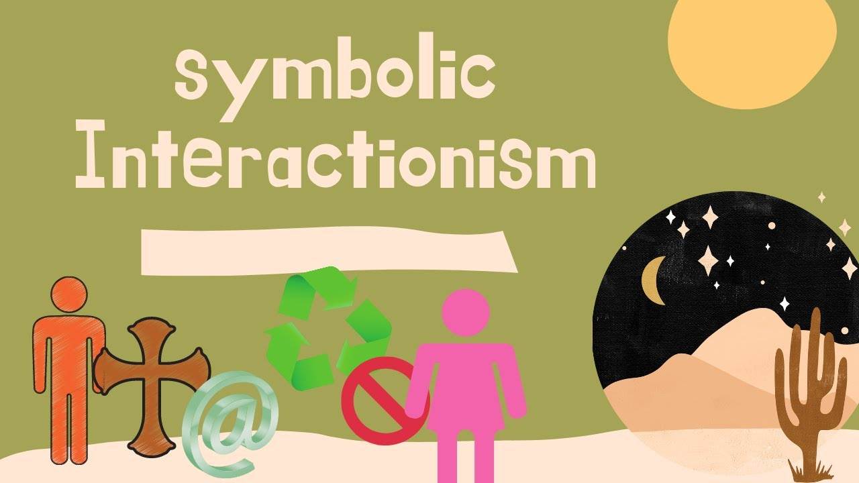
3.
Microsociological Theory

Slide 29
3. Symbolic Interactionism
Although symbolic interactionism traces its origins to Max Weber's assertion that individuals act according to their interpretation of the meaning of their world, the American philosopher George Herbert introduced this perspective to American sociology in the 1920s.
For symbolic interactionists, society is produced and reproduced through our interactions with each other by means of language and our interpretations of that language.
Symbolic interactionism is concerned with the meanings that people place on their own and one another’s behavior.

Slide 30
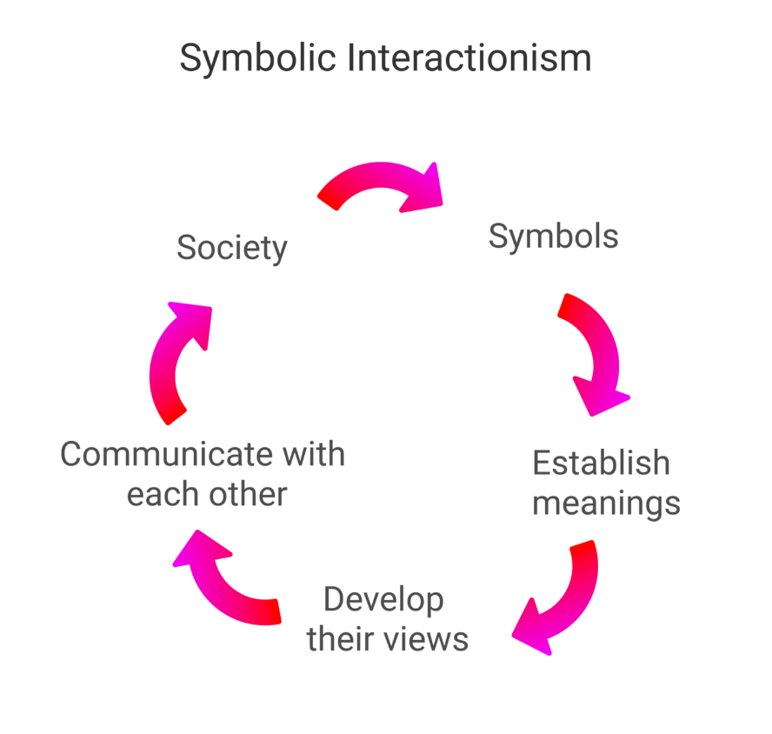
Symbolic interactionism sees face-to-face interaction as the building block of everything else in society, because it is through interaction that we create a meaningful social reality.
Example: Why would young people smoke cigarettes even when all objective medical evidence points to the dangers of doing so?
Itanalyzes society by addressing the subjective meanings that people impose on objects, events, and behaviors.

Slide 31



Applying Symbolic Interactionism
https://symbolsage.com/powerful-symbols-list/

Slide 32
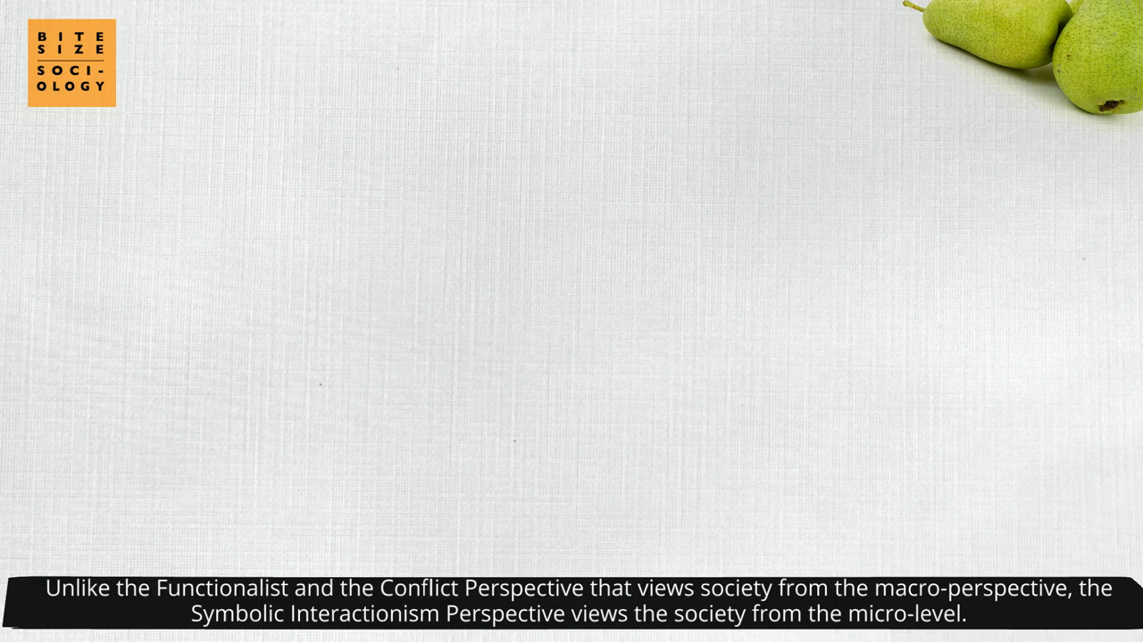
Symbolic Interactionism
https://www.youtube.com/watch?v=fGJgPugeOFU

Slide 33
Three basic principles of Symbolic Interactionism
1. We act toward things on the basis of their meanings.
For example, a tree can provide a shady place to rest, or it can be an obstacle to building a road or home; each of these meanings suggests a different set of actions.
2. Meanings are not inherent; rather, they are negotiated through interaction with others.
3. Meanings can change or be modiﬁed through interaction.

Slide 34
Advantages and Critiques
The only perspective that assumes an active, expressive model of the human actor and that treats the individual and the social at the same level of analysis.
One of symbolic interactionism’s most enduring contributions is in the area of research methods.
Critiques argue that the scope of symbolic interactionism is limited, that it cannot address the most important sociological issues, and that its authority is restricted to the study of face-to-face interaction.

Slide 35
Functionalism
Social stability is a prerequisite for a healthy and strong society.
Conflict Theory
Society is built upon equality on the basis of social class, gender, race etc.
Social institutions maintain power and inequality.
Symbolic Interactionism
Interactions are done through the exchange of words, signs and symbols which have the power to shape thought.
Social institutions maintain social order.

Slide 36

A functionalist might focus on how social institutions in our society respond to the Black Lives Matter protestors by slowly changing to address some of the related issues in order to maintain a stable society.
In response to the same protest, a conflict theorist might focus their lens on how inequalities embedded in our social institutions create tensions between groups of people and contribute to societal instability.
Instead of a broad view, a symbolic interactionist uses a much more finely focused lens to bring into view the relations between individuals and small groups. In response to the same Black Lives Matter protest, a symbolic interactionist might try to understand what motivates individuals to join the protest or what meanings their signs or chants.

Slide 37

Applying the Approaches
The Function of Sports
Sports as Interaction
Sports and Conflict

Slide 39


